Slide 1
Stationery Management System
Fundamental Of Programming
Project – 1st Semester

Slide 2
Meet Our Team
Member 1
Member 2
Member 3
Member 4

Slide 3
Main Feature OF Project
1
Multiple Menu options
Welcome note for user
2
showing four Main different option to user to chose from
A Welcome note and introduction by using basics commands of cout to welcome the user
3
Repetition
Discount Option
4
The continuous use of loop so the program
could not be terminated
without user permission
A 10% or 5 % Discount on purchase of
worth rupees more then 1000 or 2500 respectively

Slide 4
Options available for the User
Product Variety
Ability to change Price and Quantity
Include 3 predefined items with predefined prices and quantity
Which can be changed by Staff
Program offers the option to change quantity and price
of the product which can be accessed by Staff only
1
2
3
Auto Apply Discount
When the required criteria is fulfilled the program auto applies the discount and show before and after value

Slide 5
Room For Improvment
Interface
Clound Computing
Making a user friendly interface for
users or customers using UI/UX
Using drives and servers for shifting it to online store
With remote access for customer and Staff
1
2
3
Customer Experience
Adding a feedback options for the customer to get
review and make space fro improvment

Slide 6
Why Choose Stationery Store
Practical Application
Maintaining Data
Up to Date
The basic use of C++ commands in order to make a management system
Managing the stationary store online for maintain data which reduce chances of Human Error
Efficient and up-to-date, it ensures real-time data updates for seamless performance

Slide 7
C++ Component Main Used
Initializing the main variables and using the required components
Initialization
Loops (Do-While)
For repitions of programs and user choice
IF-Else-IF (with multiple Nested’s)
Making Multiples casses for items and stocks

Slide 8




Project Flowchart
Start - Stop
Using Oval shapes
Displaying outputs or taking inputs
Using Diagonals shapes
Making Decisions
Use diamond shape
Showing Flow
Making flow using arro

Slide 9
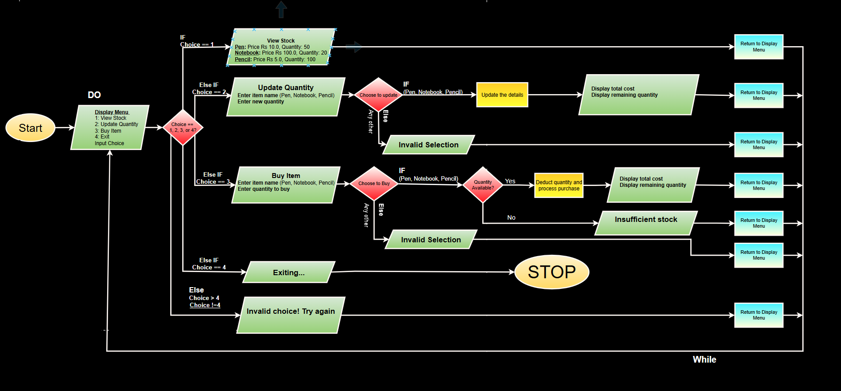
Basic Project Flowchart

Slide 10
Limitations
Pre – Defined Entries
Limited Entries
Lack of interface
Program crashing at certain points

Slide 11
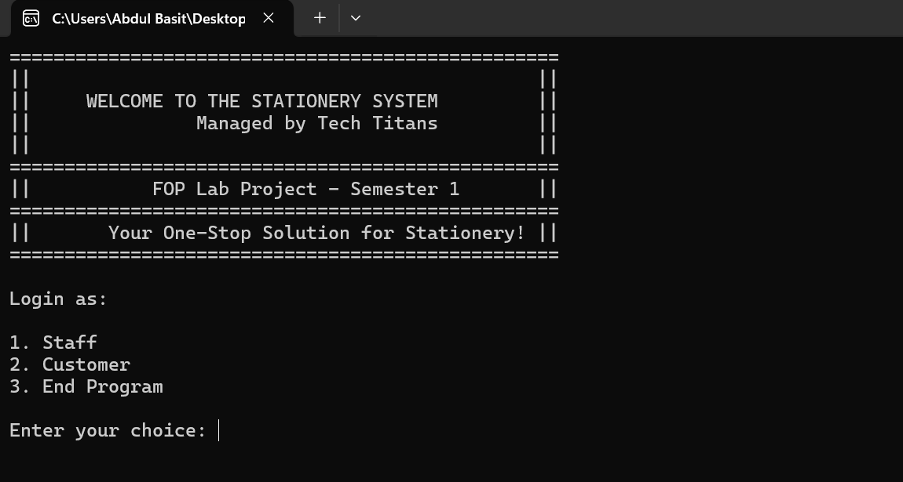

Output Screen
Project Code

Slide 12



Links for Project
Project Report-PDF
Flowchart - Drawio
Program – G-Doc
Click Icon to open from web and heading to open from the Computer
Click Icon to open from web and heading to open from the Computer
Click Icon to open from web and heading to open from the Computer

Slide 13

Questions?

Slide 14
Thank you!!

